Slide 2
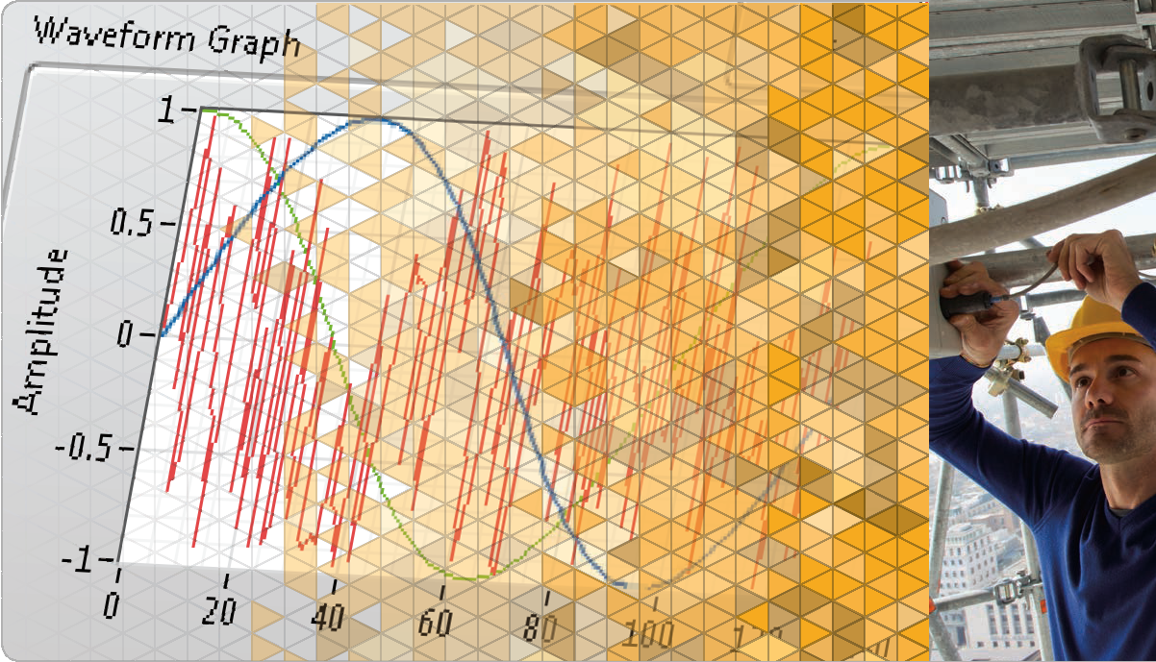
LabVIEW Core 1

Slide 3
Welcome to LabVIEW Core 1
Course Learning Map
Lesson 1
Troubleshooting and Debugging VIs
Lesson 4
Lesson 2
Navigating LabVIEW
Creating Your First Application
Lesson 3
Using Loops
Lesson 5
Modularity
Lesson 6
Creating and Leveraging Data Structures
Using Decision-Making Structures
Lesson 7
Lesson 8
Using Sequential and State Machine Programming
Lesson 9
Acquiring Measurements with Hardware
Accessing Files in LabVIEW
Lesson 10

Slide 4
Lesson 2 Creating Your First Application
Use Express VIs to produce a project and simple VI that acquires and analyzes data and then displays the results.
Dataflow
LabVIEW Data Types
Tools for Programming, Cleaning and Organizing Your VI
Building a Basic VI

Slide 5
C. Tools for Programming, Cleaning, and Organizing Your VI
Recognize tools for making clean, readable front panels and block diagrams, and for documenting VIs.
Programming Tools
Wiring Tips
Making Code Readable

Slide 6

Programming Tools
Automatic tool selection
Tools Palette
Notes:
By default, LabVIEW selects tools for you based on the context of your cursor. If you need more control over which tool is selected, use the Tools palette to select a specific tool to operate or to modify front panel and block diagram objects. Select View»Tools Palette to display the Tools palette.

Slide 7
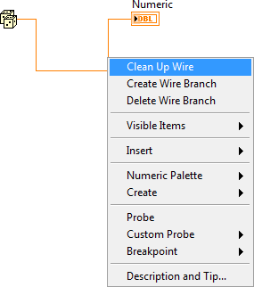
Wiring Tips

Slide 8
Exercise 2-1
Selecting a Tool
Become familiar with automatic tool selection and the Tools palette in LabVIEW.
Notes:
This is the first exercise spent entirely in LabVIEW. They will experience resizing, moving, selecting objects, and wiring. Spend extra time here if necessary until students are comfortable with the automatic tool selection.

Slide 9
Exercise 2-1
Selecting a Tool
How do you enable automatic tool selection?
Notes:
How do you enable automatic tool selection?
Make sure that the Automatic Tool Selection button is enabled on the Tools palette. To view the Tools palette, you can either select View»Tools Palette or hold the <Shift> key while right-clicking the front panel.

Slide 10
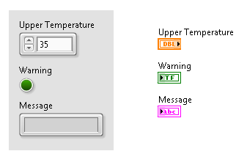
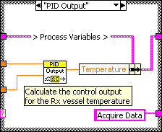
Making Code Readable
Notes:
Front panel controls and indicators create terminals on the block diagram. The front panel is the user interface. Usually you start a VI with inputs and outputs on the front panel. The block diagram is the programming behind the user interface. After you build the front panel, you add code on the block diagram to control the front panel objects.
The labels of the front panel objects become the identifying labels for the terminals on the block diagram.
You can also set default values for controls and indicators.

Slide 11
D. Building a Basic VI
Recognize Express VIs and be able to apply them appropriately.

Slide 12
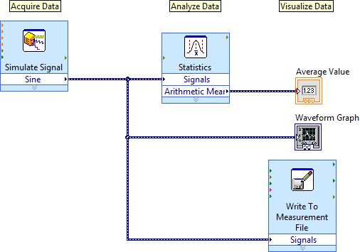
D. Building a Basic VI
Building a Basic VI

Slide 13

Activity 2-2
Program Architecture for Simple AAV VI
Refer to the participant guide to answer questions about the program architecture of a simple AAV VI and then discuss the answers as a group.

Slide 14
Exercise 2-2
Simple Acquire, Analyze, and Visualize VI
Create a simple VI that acquires data, analyzes data, and displays the results.
Notes:
Students that do not have DAQ hardware can use the Simulate Signal Express VI to generate a waveform.
The instructions in the Exercise manual guide students through the process of creating the VI

Slide 15
Exercise 2-2
Simple Acquire, Analyze, and Visualize VI
How do you determine the file path of the generated text file?
Notes:
What is the file path of the generated text file?
The file path of the text file is configured in the Write To Measurement File Express VI.
Double-click the Write To Measurement File Express VI to find the file path of the text file.

Slide 16
Activity 2-3
Lesson Review
Refer to the participant guide to answer questions about what you have learned in this lesson and then discuss the answers as a group.

Slide 17

Lesson Review
Which function executes first: Add or Subtract?
Add
Subtract
Unknown
Notes:
The answer is a.

Slide 18
Lesson Review
Which function executes first: Add or Subtract?
Add
Subtract
Unknown

Slide 19

Lesson Review
Which function executes first: Sine or Divide?
Sine
Divide
Unknown
Notes:
The answer is b.

Slide 20
Lesson Review
Which function executes first: Sine or Divide?
Sine
Divide
Unknown

Slide 21
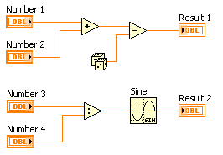
Lesson Review
Which of the following functions executes first: Random Number, Add or Divide?
Random Number
Divide
Add
Unknown
Notes:
The answer is d.

Slide 22
Lesson Review
Which of the following functions executes first: Random Number, Add or Divide?
Random Number
Divide
Add
Unknown

Slide 23
Lesson Review
Which of the following functions executes last: Random Number, Subtract or Add?
Random Number
Subtract
Add
Unknown
Notes:
The answer is b.

Slide 24
Lesson Review
Which of the following functions executes last: Random Number, Subtract or Add?
Random Number
Subtract
Add
Unknown

Slide 25
Lesson Review
If an input to a function is marked with a red dot (known as a coercion dot), what does the dot indicate?
Data was transferred into a structure.
That input has not been wired
The wire is broken
The value passed into a node was converted to a different representation.
Notes:
Answer is d.

Slide 26

Lesson Review
If an input to a function is marked with a red dot (known as a coercion dot), what does the dot indicate?
Data was transferred into a structure.
That input has not been wired
The wire is broken
The value passed into a node was converted to a different representation.

Slide 27
Lesson Review
Which mechanical action causes a Boolean control in the FALSE state to change to TRUE when you click it and stay TRUE until LabVIEW has read the value?
Switch Until Released
Switch When Released
Latch When Pressed
Latch When Released
Notes:
Answer is c.

Slide 28
Lesson Review
Which mechanical action causes a Boolean control in the FALSE state to change to TRUE when you click it and stay TRUE until LabVIEW has read the value?
Switch Until Released
Switch When Released
Latch When Pressed
Latch When Released

Slide 29
Homework activity instruction: Complete LabVIEW Module 6
Complete LabVIEW Module 6 on LearnNI.com

Slide 30
Lesson 3
Troubleshooting and Debugging VIs
Fix a broken VI, debug incorrect results and behavior of a running VI, and display errors generated by functions while a VI is running.
Correcting Broken VIs
Debugging Techniques
Error Handling

Slide 31
A. Correcting Broken VIs
Recognize an unexecutable VI and restate common problems.

Slide 32

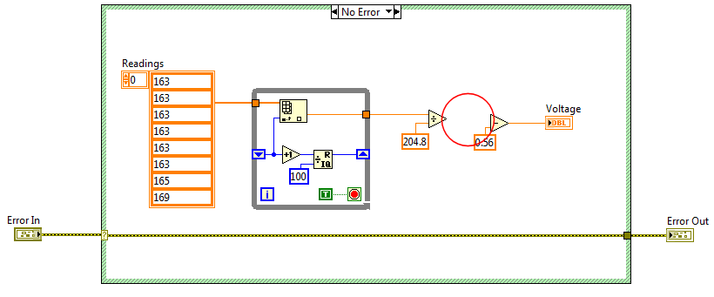
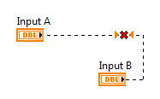
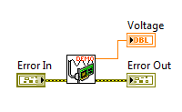

A. Correcting Broken VIs
Common Causes of Broken VIs

Slide 33
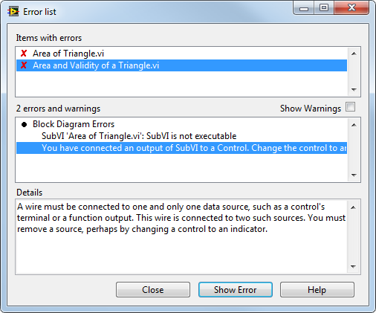
A. Correcting Broken VIs
Identify Problems and Fix Broken VIs

Slide 34
B. Debugging Techniques
Identify the LabVIEW tools for debugging and select the tool appropriate to the situation.
Debugging Tools Review
Breakpoints
Undefined or Unexpected Data

Slide 35


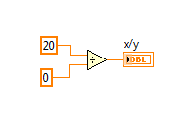
B. Debugging Techniques
Debugging Tips
Refer to the LabVIEW Core 1 Participant Guide for the Debugging Techniques job aid.

Slide 36
Activity 3-1
Review Debugging Tools
Select the LabVIEW debugging tool you would use in different scenarios.

Slide 37
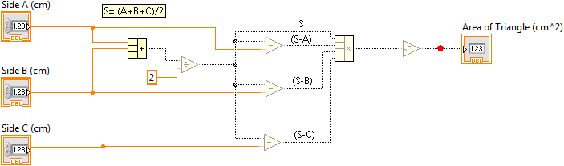
B. Debugging Techniques
Breakpoints

Slide 38
B. Debugging Techniques
Retain Wire Values
Allows you to probe wire values after a VI runs

Slide 39

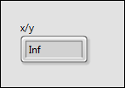
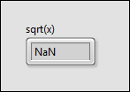
B. Debugging Techniques
Undefined or Unexpected Data

Slide 40
Exercise 3-1
Debugging
Use debugging tools and troubleshooting techniques to fix a broken VI that returns unexpected data.

Slide 41
Exercise 3-1
Debugging
If you have a VI with a broken Run arrow, what should you do first?
After you fixed your broken Run arrow, your VI results show unexpected data. What can you do next?

Slide 42
C. Error Handling
Describe the difference between automatic and manual error handling.
Error Handling Review
Automatic vs. Manual Error Handling
Merge Errors Function
Error Clusters
Errors and Warnings

Slide 43

C. Error Handling
Error Handling Review
Error Handling – Anticipation, detection and resolution of warnings and errors
Automatic Error Handling – At run time, LabVIEW suspends execution, highlights node, and displays Error dialog box
Manual Error Handling – You control when dialog boxes appear, propagate errors with error clusters, terminate error chain with Simple Error Handler VI

Slide 44
Automatic vs. Manual Error Handling
Demonstrate the difference between automatic and manual error handling.

Slide 45
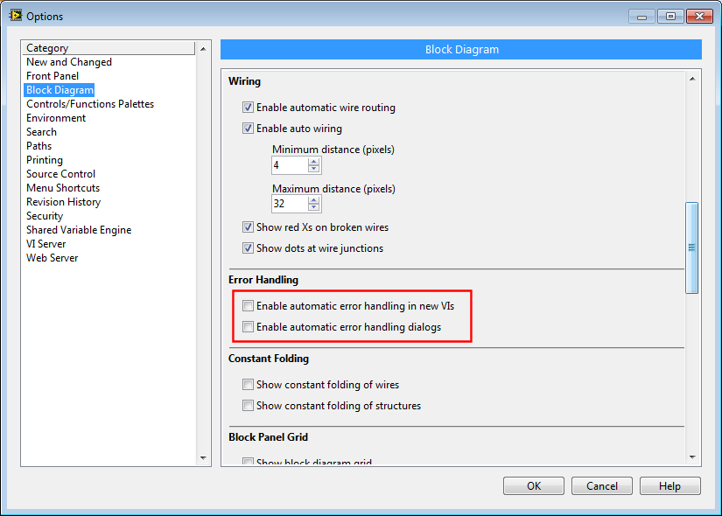
C. Error Handling
Disable Automatic Error Handling

Slide 46
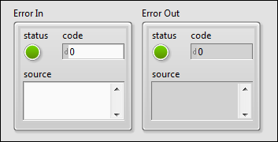
C. Error Handling
Error Clusters

Slide 47
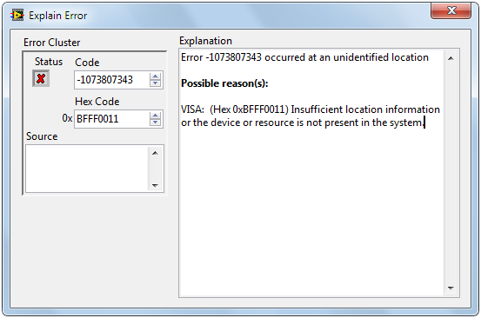
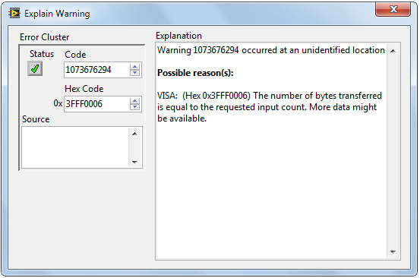
C. Error Handling
Errors and Warnings
Error | Warning
Status = TRUE (8) Code = Non-zero | Status = FALSE (4) Code = Non-zero

Slide 48
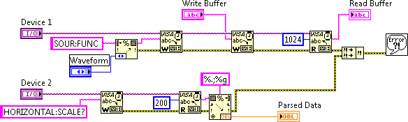
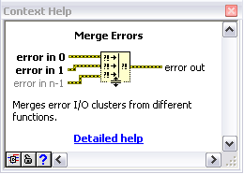
C. Error Handling
Merge Errors

Slide 49

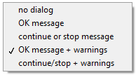
C. Error Handling
Errors and Warnings Recommendations

Slide 50
Activity 3-2
Lesson Review
Refer to the participant guide to answer questions about what you have learned in this lesson and then discuss the answers as a group.

Slide 51
Lesson Review
Which of the following will result in a broken run arrow?
A subVI is broken
The diagram includes a divide by zero
A required subVI input is unwired
A Boolean terminal is wired to a numeric indicator
Notes:
Answer is a, c, and d.

Slide 52
Lesson Review
Which of the following will result in a broken run arrow?
A subVI is broken
The diagram includes a divide by zero
A required subVI input is unwired
A Boolean terminal is wired to a numeric indicator
Notes:
A divide by zero might cause unexpected results but will not cause the run arrow to be broken.

Slide 53
Lesson Review
Which of the following are the components and data types of the error cluster?
Status: Boolean
Error: String
Code: 32-bit integer
Source: String
Notes:
Answer is a, c, and d.

Slide 54
Lesson Review
Which of the following are the components and data types of the error cluster?
Status: Boolean
Error: String
Code: 32-bit integer
Source: String

Slide 55
Lesson Review
All errors have negative error codes and all warnings have positive error codes.
True
False
Notes:
Answer is b.

Slide 56
Lesson Review
All errors have negative error codes and all warnings have positive error codes.
True
False
Notes:
Answer is b.

Slide 57
Lesson Review
Merge Errors function concatenates error information from multiple sources.
True
False
Notes:
Answer is b.

Slide 58
Lesson Review
Merge Errors function concatenates error information from multiple sources.
True
False
Notes:
Answer is b.

Slide 59
Lesson 4
Using Loops
Recognize the different components of a LabVIEW loop structure and apply a For Loop or a While Loop appropriately
Loops Review
While Loops
For Loops
Timing a VI
Data Feedback in Loops
Plotting Data

Slide 60
A. Loops Review
Recognize loop structures and explain how to use them.
While Loops—Review
For Loops—Review
For Loop/While Loop Comparison

Slide 61
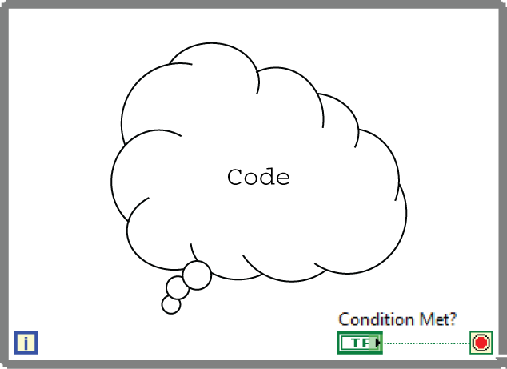
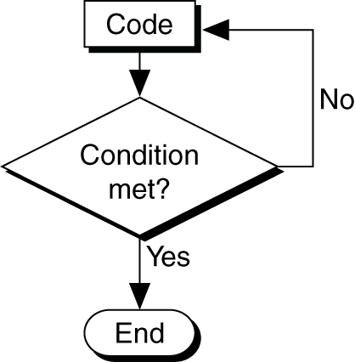
A. Loops Review
While Loops—Review

Slide 62
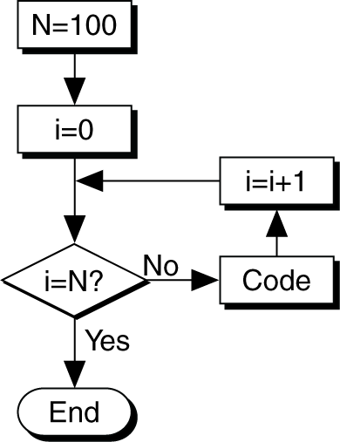
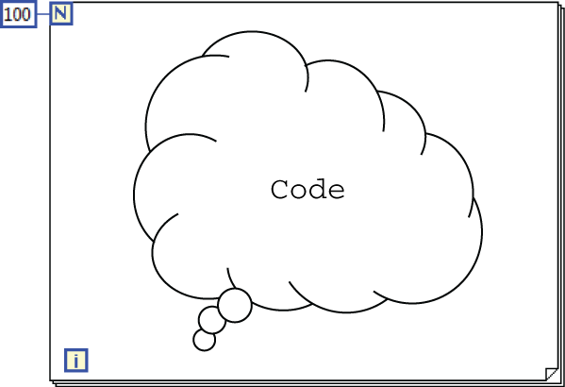
A. Loops Review
For Loops—Review

Slide 63
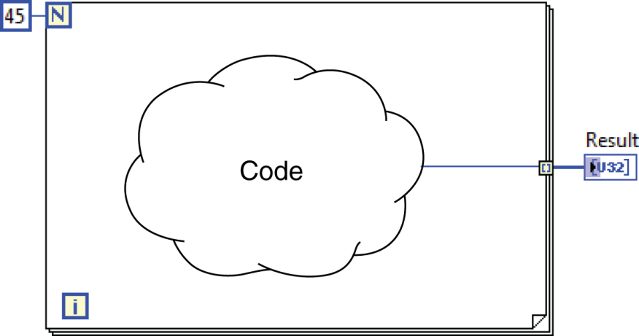
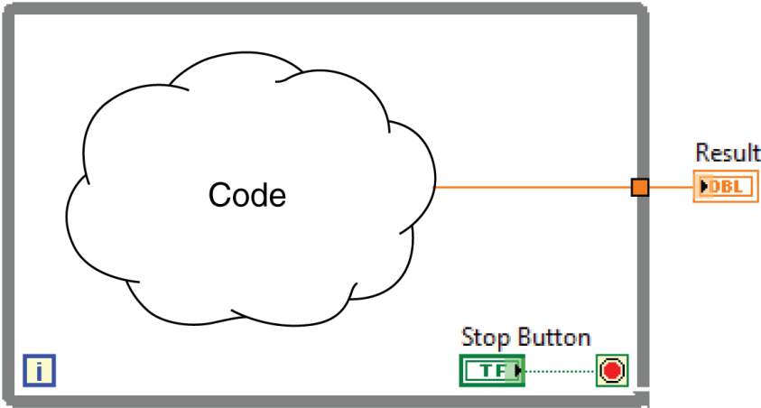
A. Loops Review
For Loop/While Loop Comparison

Slide 64
Activity 4-1
While Loops vs. For Loops
Review four scenarios and determine the best type of loop to use for each one.

Slide 65
B. While Loops
Recognize tunnels and explain their purpose on a loop structure and demonstrate how to use error checking and error handling inside a loop.
Tunnels
Error Checking and Error Handling

Slide 66
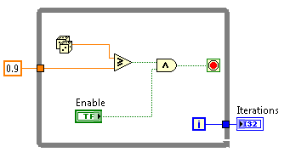
B. While Loops
Tunnels

Slide 67
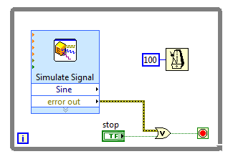
B. While Loops
Error Checking and Error Handling
Stop the While Loop if an error occurs.

Slide 68
Exercise 4-1
Pass Data Through Tunnels
Use a While Loop and an iteration terminal and pass data through a tunnel.

Slide 69
Exercise 4-1
Pass Data Through Tunnels
How many times is the Number of Iterations indicator updated? Why?
Why do we include the Increment function?

Slide 70
C. For Loops
Demonstrate how to add a conditional terminal to a For Loop and describe how numeric conversion occurs on the For Loop count terminal.
Conditional Terminal
Count Terminal Numeric Conversion

Slide 71
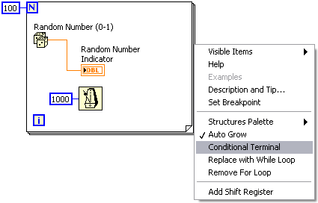
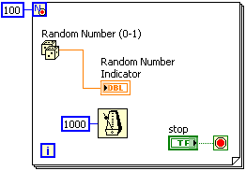
C. For Loops
Conditional Terminal

Slide 72
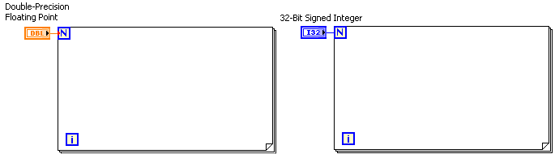
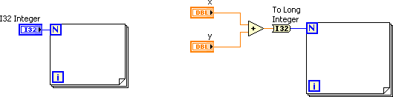
C. For Loops
Count Terminal Numeric Conversion

Slide 73
D. Timing a VI
Identify scenarios that require loop timing and apply the appropriate function.
Reasons to Use Timing
Wait Functions and Express VIs

Slide 74
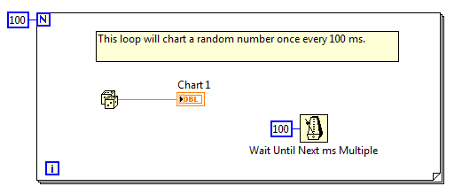
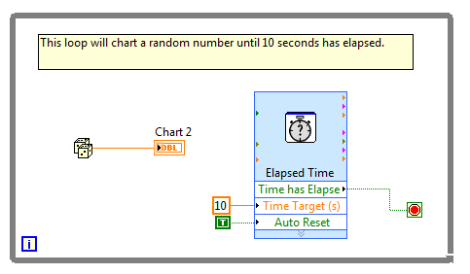
D. Timing a VI
Why do you need timing in a VI?

Slide 75
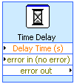
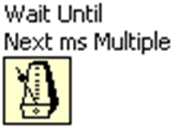
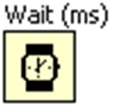
D. Timing a VI
Wait Functions Inside a Loop

Slide 76
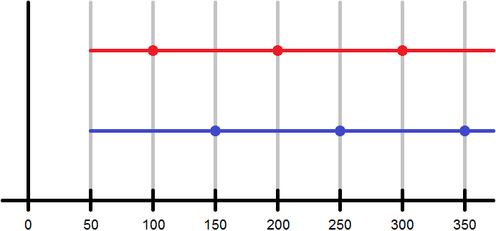
D. Timing a VI
Wait Function Timing

Slide 77
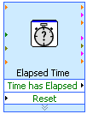
D. Timing a VI
Elapsed Time Express VI

Slide 78

Wait Chart VI
Compare and contrast using a Wait function and the Elapsed Time Express VI for software timing.

